Slide 1
How does government debt affect productivity?
Ian Tufts
November 14, 2021
George Washington University

Slide 2
Research Question: Does the level of government debt affect long-term productivity growth?
Productivity is an important determinant for a country’s long-term prosperity.
Much economic research already suggests that high levels of government debt “crowd out” resources that would otherwise be used for investment, leading to slower GDP growth. (Reinhart & Rogoff, 2010), (Afonso & Jalles, 2013), (Kumar & Woo, 2015)
  This has important implications for economic policy, particularly when it comes to fiscal policy.
  It may become necessary to think about in the near future, as U.S. and other governments have racked of massive debts in response to COVID-19.
The research paper involves taking a similar approach, in finding the influence of government debt on productivity.

Slide 3
Importance
While productivity is something of an amorphous concept to many, it is nonetheless a crucial factor in predicting and generating rising living standards.
The U.S. and other countries have issued significant debt since early 2020 in response to the pandemic.
Past research has indicated that this can have negative effects on a country’s long-term prospects for improving living standards.
It is not wise to suggest that a country can count on low interest rates forever.

Slide 4
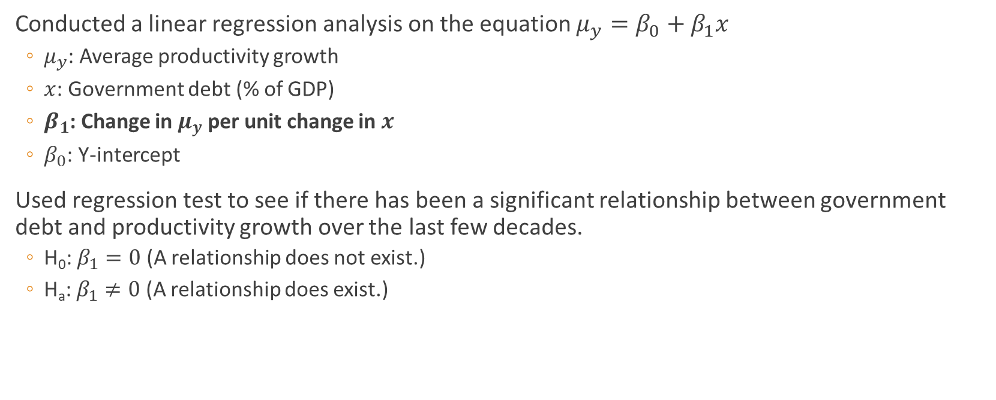
Hypothesis: If government debt increases, then the growth rate of labor productivity will decrease.
Conducted a linear regression analysis on the equation $μ_{y}=β_{0}+β_{1}x$
  $μ_{y}$: Average productivity growth
  $x$: Government debt (% of GDP)
  $β_{1}$: Change in $μ_{y}$ per unit change in $x$
  $β_{0}$: Y-intercept
Used regression test to see if there has been a significant relationship between government debt and productivity growth over the last few decades.
  H₀: $β_{1}=0$ (A relationship does not exist.)
  H_{a}: $β_{1}≠0$ (A relationship does exist.)

Slide 5
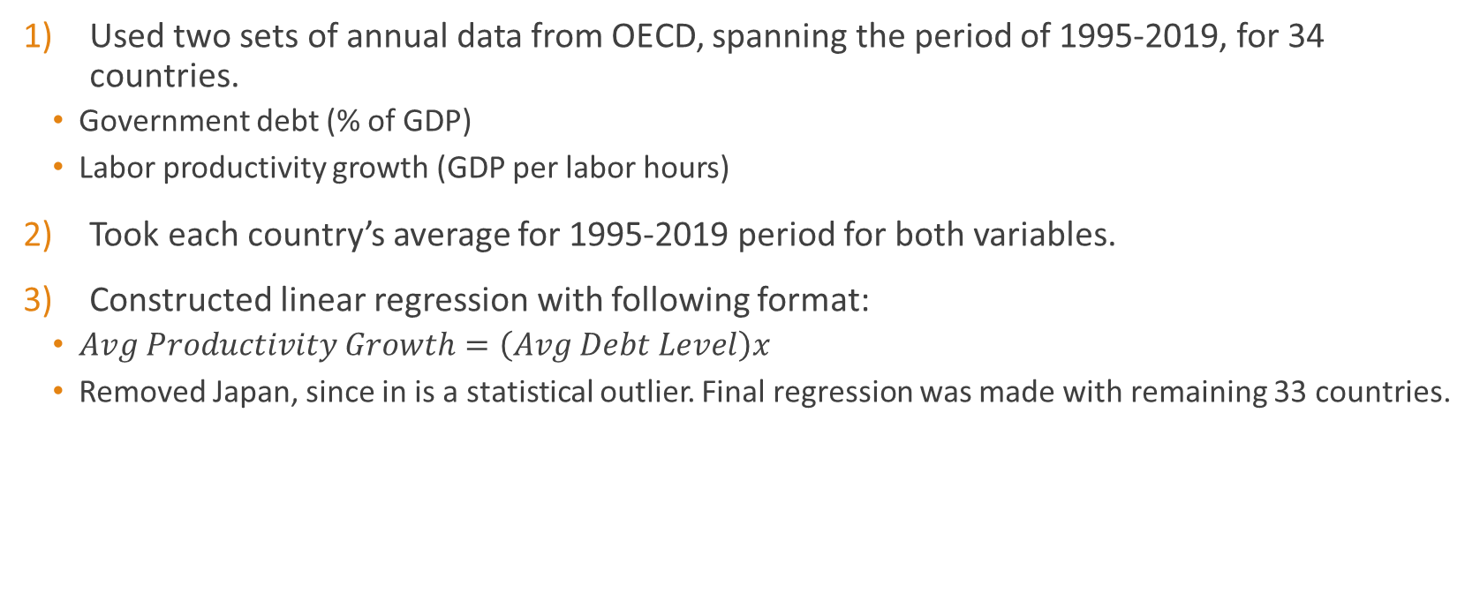
Data & Method
Used two sets of annual data from OECD, spanning the period of 1995-2019, for 34 countries.
  Government debt (% of GDP)
  Labor productivity growth (GDP per labor hours)
Took each country’s average for 1995-2019 period for both variables.
Constructed linear regression with following format:
  $Avg Productivity Growth=\left(Avg Debt Level\right)x$
  Removed Japan, since in is a statistical outlier. Final regression was made with remaining 33 countries.

Slide 6
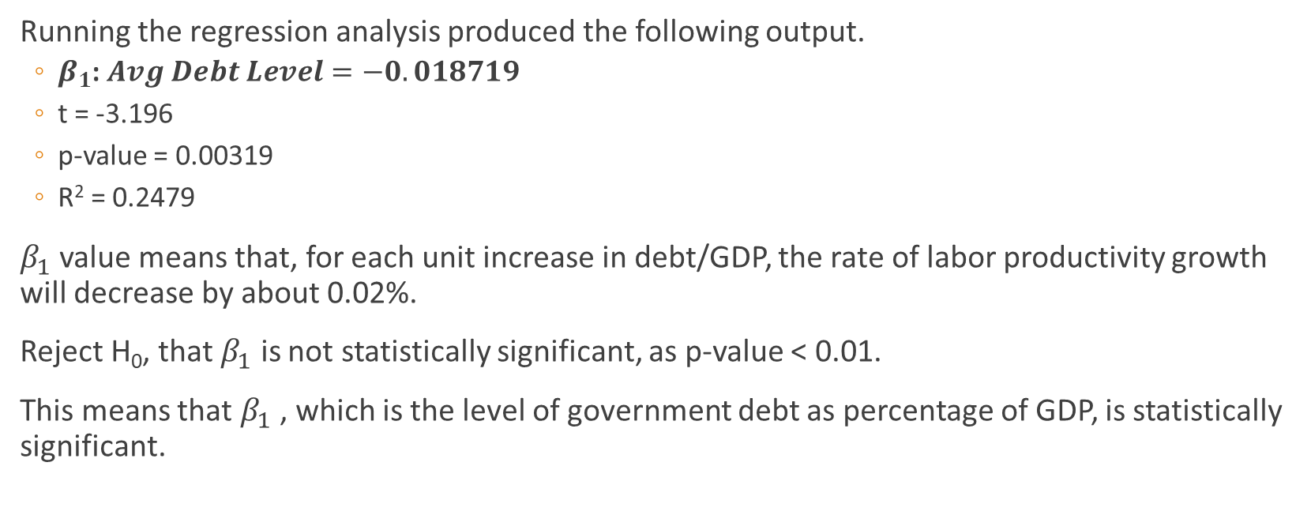
Results
Running the regression analysis produced the following output.
  $β_{1}$: $Avg Debt Level=−0.018719$
  t = -3.196
  p-value = 0.00319
  R² = 0.2479
$β_{1}$ value means that, for each unit increase in debt/GDP, the rate of labor productivity growth will decrease by about 0.02%.
Reject H₀, that $β_{1}$ is not statistically significant, as p-value < 0.01.
This means that $β_{1}$ , which is the level of government debt as percentage of GDP, is statistically significant.

Slide 7
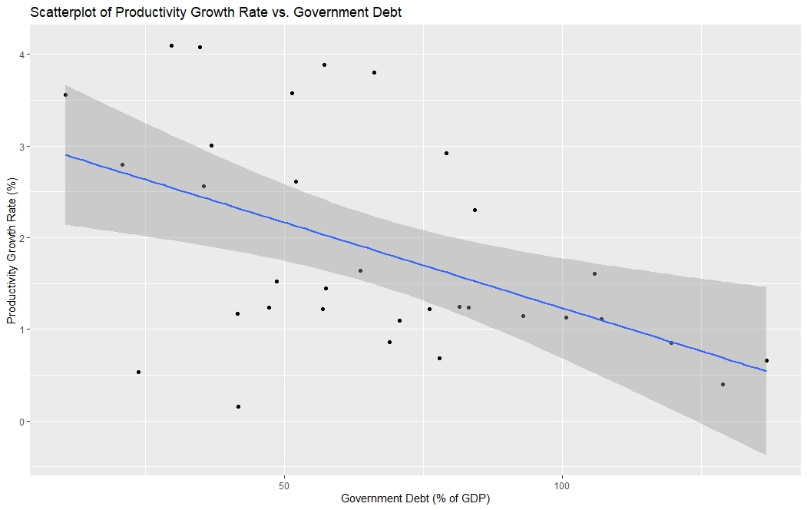

Slide 8
Conclusions & Limitations
There does appear to be a relationship, albeit a somewhat small one, between the level of government debt and labor productivity.
Further research would be necessary to see how massive debt, which was issued in response to the pandemic, affects future long-term growth prospects.
Limitations:
  Many other factors also matter, such as political environment and interest rate on government bonds.

Slide 9
References
Afonso, A. and Jalles, J.T. (2013), Growth and productivity: The role of government debt. International Review of Economics & Finance, 25, 384-407, ISSN 1059-0560, https://doi.org/10.1016/j.iref.2012.07.004.
Reinhart, C., & Rogoff, K. (2010). Growth in a Time of Debt. The American Economic Review, 100(2), 573-578. Retrieved April 20, 2021, from http://www.jstor.org/stable/27805061
Woo, J. and Kumar, M.S. (2015). Public Debt and Growth. Economica, 82, 705-739. https://doi-org.proxygw.wrlc.org/10.1111/ecca.12138

